Slide 1
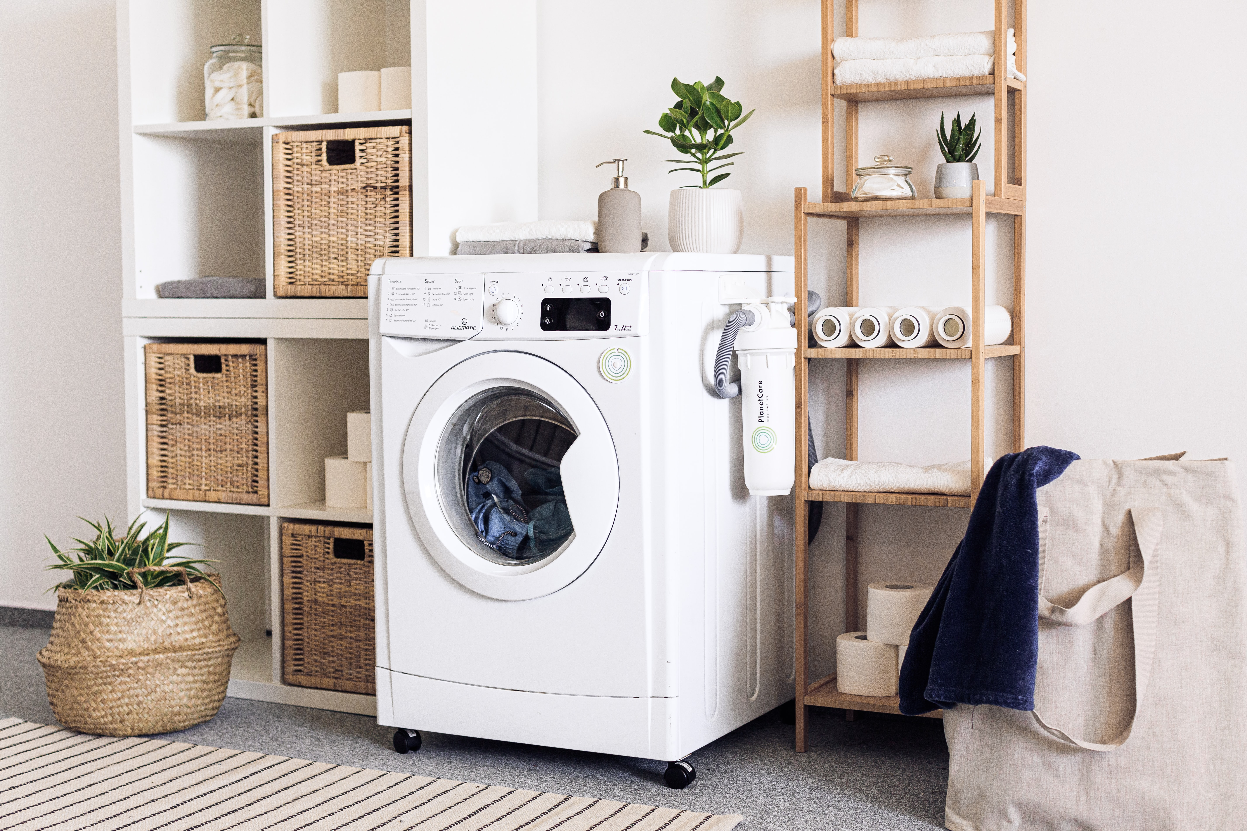
Washing Machine Controller
Designed by: Yousef Sherif

Slide 2
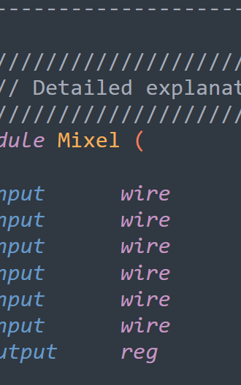
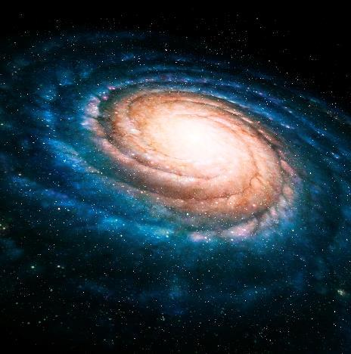

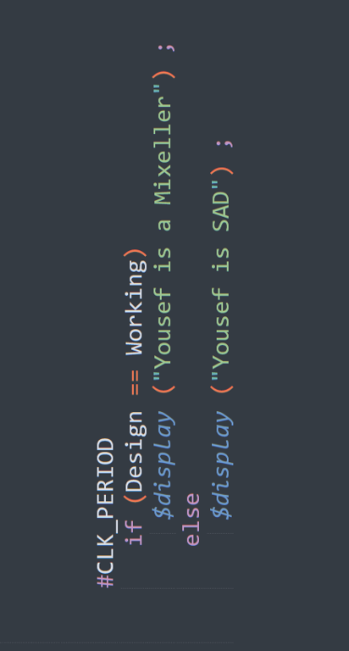

Content
1) Requirements
2) Solution and Design Flow
3) Detailed Explanation of My Code
4) The Testing Covered Scenarios

Slide 3
Requirements
.

Slide 4
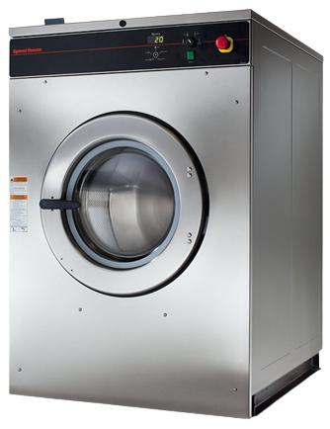
Requirements
What is the washing machine supposed to do?

Slide 5



Requirements
The machine starts when a coin is deposited.
There is a double wash button. When it is pressed, a second wash and rinse to occur after completing the first rinse.
There is a pause button. When it is pressed, during the spin cycle, the machine stops spinning until the button is pressed again.

Slide 6
Requirements
Each state of this machine takes a time period as stated below
Filling Water
2 Minutes
Washing
5 Minutes
Rinsing
2 Minutes
Spinning
1 Minute

Slide 7
Solution and Design flow
.

Slide 8
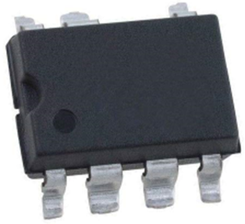
Solution and Design flow
The solution is to design a controller for the washing machine to operate as intended.

Slide 9
Solution and Design flow
clk
Finite State Machine
rst_n
clk_freq
wash_done
coin_in
Control Signals
double_wash
Timer
timer_pause

Slide 10
Solution and Design flow
Control signals are some flags to indicate the flow of the operation and the start and end of each state:
State | Control Signals
Filling | filling_start
 | filling_end
Washing | washing_start
 | washing_end
Rinsing | rinsing_start
 | rinsing_end
 | double_wash_done
Spinning | spinning_start
 | spinning_end
 | timer_pause_start

Slide 11

Moore FSM
coin_in = 0
timer_pause = 1 or spinning_end = 1
Reset
Spinning
wash_done = 0
IDLE
wash_done = 0 or 1
coin_in = 1
rinsing_end = 1
timet_pause = 0
double_wash= 1
Filling Water
wash_done = 0
Rinsing
wash_done = 0
Washing
wash_done = 0
filling_end = 1
washing_end = 1

Slide 12
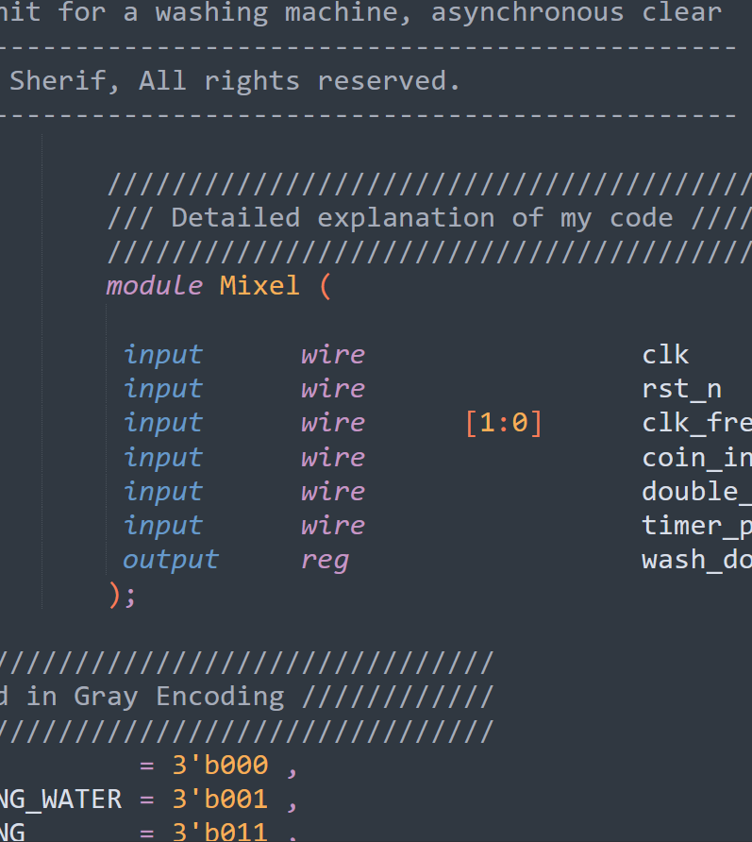
Detailed explanation of my code
.

Slide 13
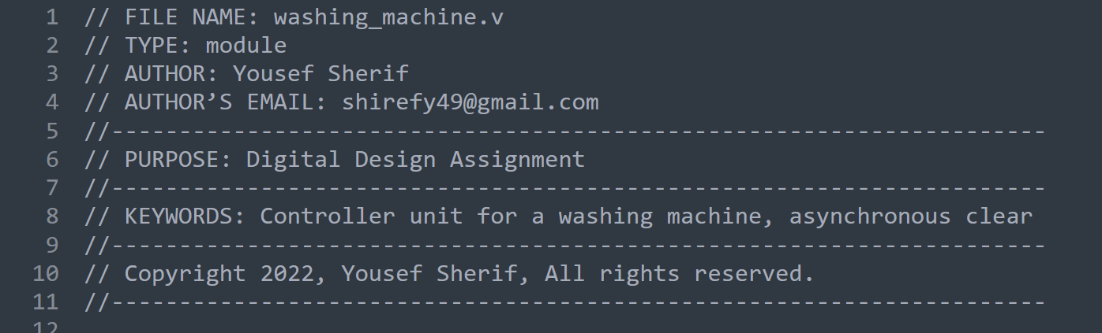
File Header
The headers include the name of the file, author, and author's email address, a purpose section explaining the functionality of the module.

Slide 14
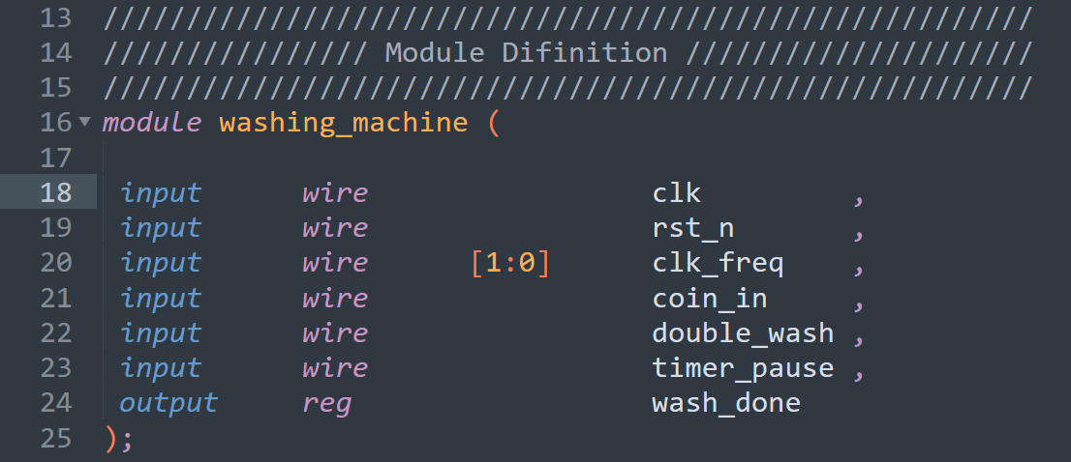
Module Definition
Each module must have a module_name, which is the identifier for the module, and a port list, which describes the input and output terminals of the module.

Slide 15
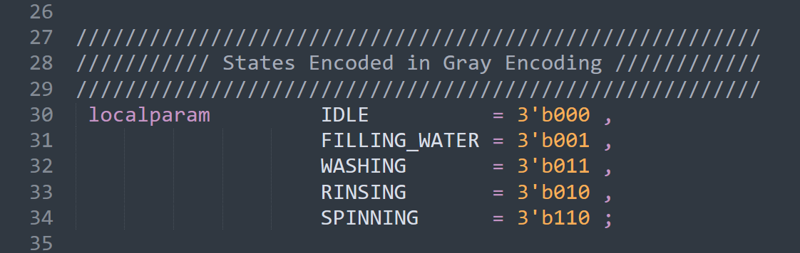
States Encoded in Gray Encoding
This block of code creates the state variables. This way each state can be referenced by name.
localparam prevents the values to be overwritten (directly) from outside the module. And, it gives descriptive names to the states.
Gray code consists of a sequence where only one bit changes between one value and the next. In addition to also using the minimum number of bits, this encoding minimizes dynamic power consumption if the sequence of states is followed optimally.

Slide 16
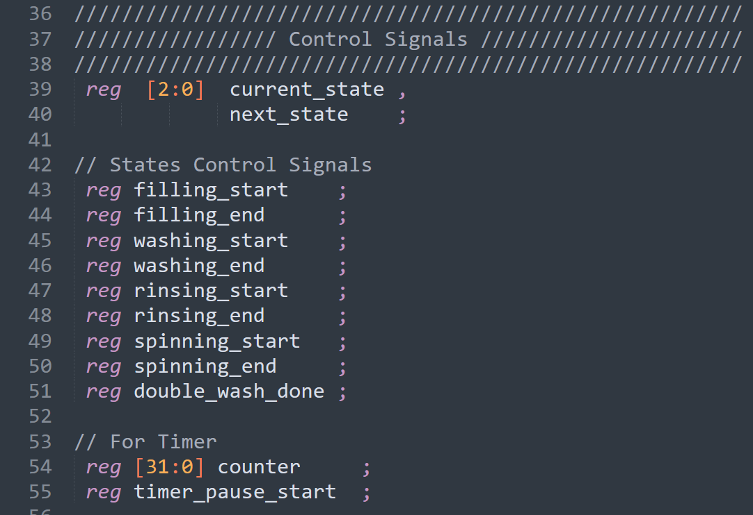
Control Signals
This block of code creates the state registers that hold the next_state and present_state variables. This is which circle you are on the state diagram.
States control signals are some flags to indicate the flow of the operation and the start and end of each state.
They are defined as reg because they are assigned variables inside an always block.

Slide 17
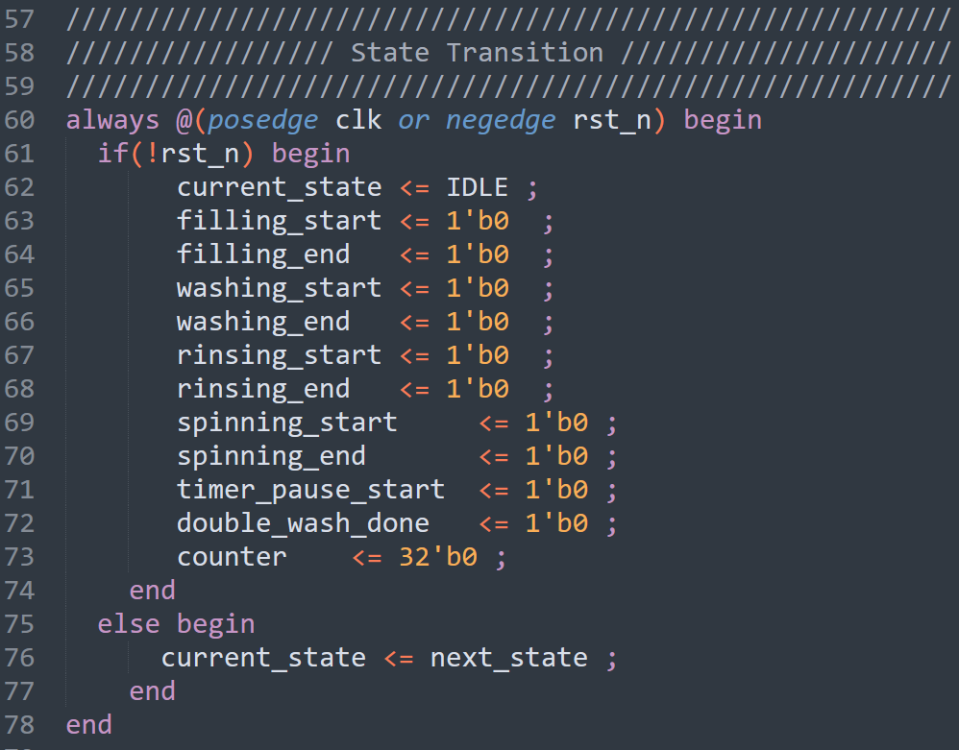
State Transition
This is the state register. It moves the next_state to the current_state at the positive clock edge. This is what makes movement between the states in the state diagram happen.
Using an active low asynchronous reset signal, we can reset all the control signals, and make the current state IDLE at the negative edge of the clock.

Slide 18
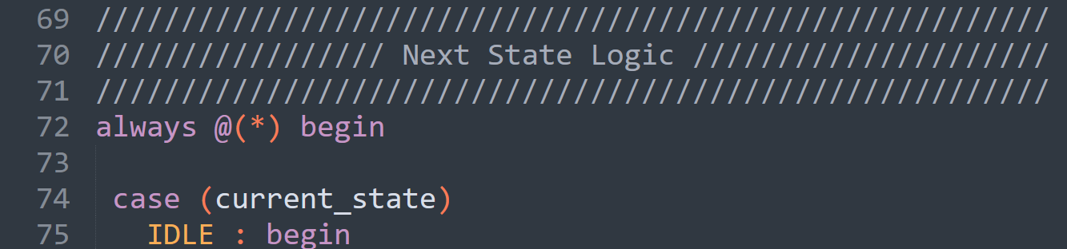
Next State Logic
Here, I am using a combinational always block to move between different states.

Slide 19
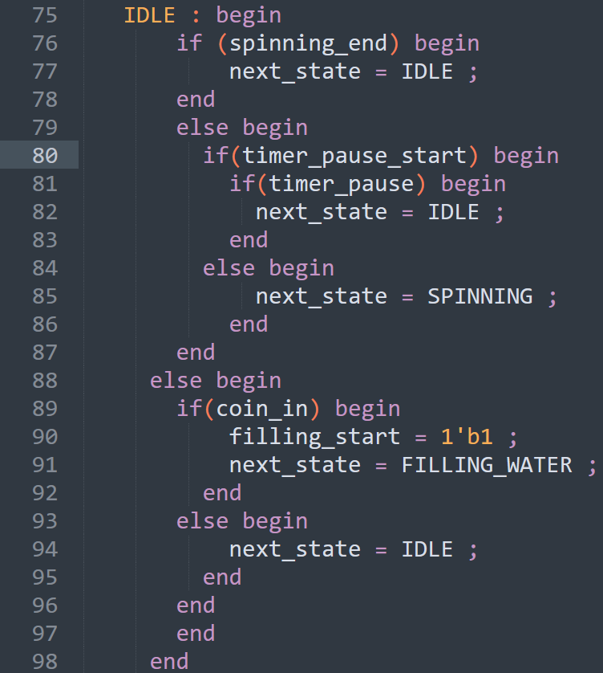
Next State Logic
This is the first chunk of the state logic. It shows, at first, if you are in the IDLE state, then the spinning_end signal (which is a signal that is set to 1 by the timer at the end of the spinning state) is zero, and the timer_pause_start signal (which is a signal that is set to 1 when the timer_pause button is pressed during the spinning state) is zero, then if there is a coin deposited in the machine, it will move to the filling water state, else, it will stay at the IDLE state waiting for a coin to be deposited. The part of code that contain the timer_pause_start, and spinning_end signals is related to other states, and I will talk more about them is the following slides.

Slide 20
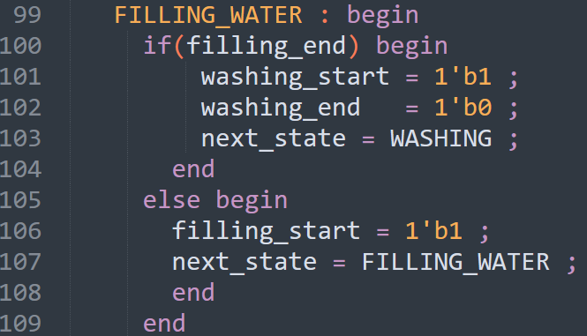
Next State Logic
This is the second chunk of the state logic. It shows, if you are in the FILLING_WATER state, and the filling is done, so, the filling_end signal is set to one by the timer, then the next state is the WASHING state, and the washing_start signal is set to one, so that the timer can start counting the time for this operation.
If the filling is not finished yet (filling_end signal is zero), the machine will stay in the FILLING_WATER state.

Slide 21
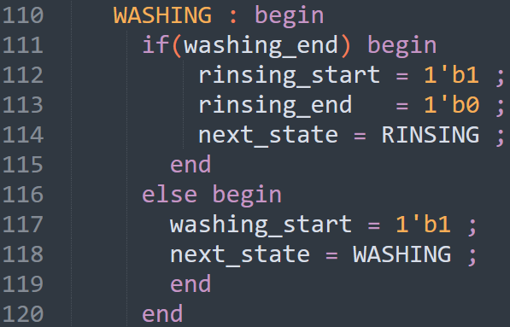
Next State Logic
This is the third chunk of the state logic. It shows, if you are in the WASHING state, and the washing is finished (washing_end signal is set to one by the timer), then the next state is the RINSING state, and the rinsing_start signal is set to one so that the timer starts counting the time for this operation.
If the washing is not finished yet (washing_end signal is zero), the machine will stay in the WASHING state.

Slide 22
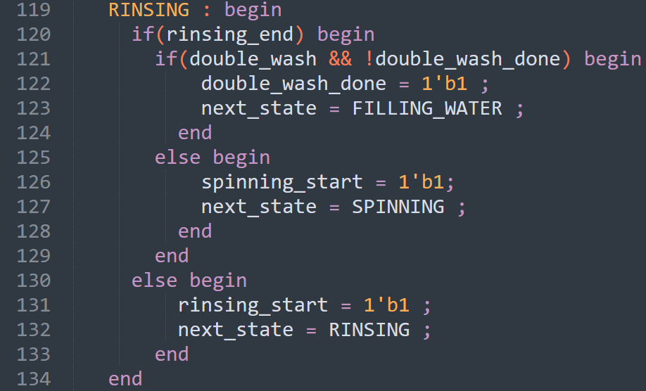
Next State Logic
This is the fourth chunk of the state logic. It shows, if you are in the RINSING state, and the rinsing is finished (rinsing_end signal is set to one by the timer), then the next state will depend on whether the double_wash button is pressed or not, if it is pressed, and the double_wash_done is initially set to 0, then the next state will be the washing state again, and the double_wash_done signal is set to 1 to ensure that the double whashing process will not accur when returning from the double wash to the rinsing. After the double wash is done, the rinsing_end is set to 1 by the timer, and the double_wash_done is set to 1, then the next state will be the spinning state, else, it will stay in the rinsing state.

Slide 23
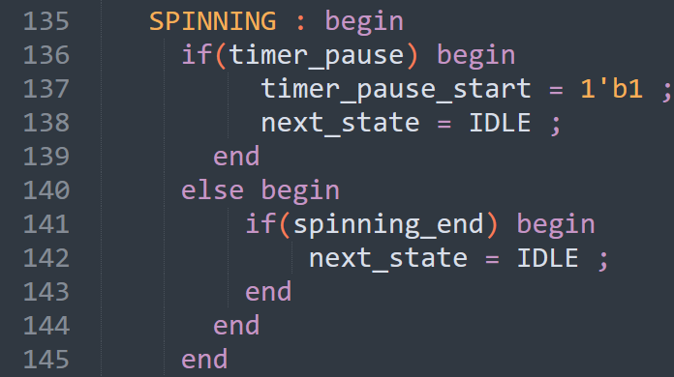
Next State Logic
This is the fifth chunk of the state logic. It shows, if you are in the SPINNING state, and the timer_pause button is not pressed, then the timer_pause signal is set to 0, and the next state will be the IDLE state, and the machine will stay in the IDLE state until the reset is done. But, if the timer pause button is pressed during spinning, then the timer_pause_start signal is set to 1, and the machine will top spinning by entering the IDLE state.

Slide 24
Next State Logic
In the IDLE state, the spinning_end signal is not set to 1 yet by the timer, as the spinning state is not finished yet, and the timer_pause_start and the timer_pause signals are both set to 1, then the machine will stay in the IDLE state until the pause button is left, and the timer_pause signal is 0. This way we ensure that the timer_pause signal has no effect on the machine at the beginning until the spinning state is reached.

Slide 25
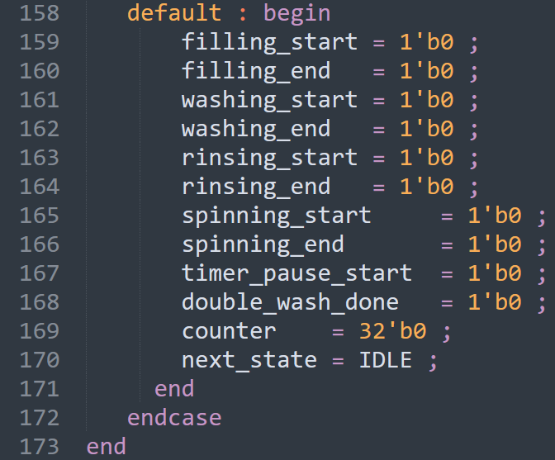
Next State Logic
This is the default case of the case statement, and it is used so that there will be no unintentional latches in the design.

Slide 26
Timer
clk = 1MHz (T period = 1 us)
Duration | Equivalent Clock Cycles
1 second | 1,000,000 clock cycles
1 minute | 60,000,000 clock cycles
2 minutes | 120,000,000 clock cycles
5 minutes | 300,000,000 clock cycles
clk = 2MHz (T period = 1/2 us)
Duration | Equivalent Clock Cycles
1 second | 2,000,000 clock cycles
1 minute | 120,000,000 clock cycles
2 minutes | 240,000,000 clock cycles
5 minutes | 600,000,000 clock cycles

Slide 27
Timer
clk = 4MHz (T period = 1/4 us)
Duration | Equivalent Clock Cycles
1 second | 4,000,000 clock cycles
1 minute | 240,000,000 clock cycles
2 minutes | 480,000,000 clock cycles
5 minutes | 1200,000,000 clock cycles
clk = 8MHz (T period = 1/8 us)
Duration | Equivalent Clock Cycles
1 second | 8,000,000 clock cycles
1 minute | 480,000,000 clock cycles
2 minutes | 960,000,000 clock cycles
5 minutes | 2400,000,000 clock cycles

Slide 28
Timer
The largest number of clock cycles will be counted by the counter signal will be 2400,000,000 clock cycles (5 minutes) in case of operating at a frequency of 8 MHz.
So, the size of the counter will be 32 bits so that it can hold this large number.
Log2(2400,000,000) = 31.160 = 32 bits approximately.

Slide 29
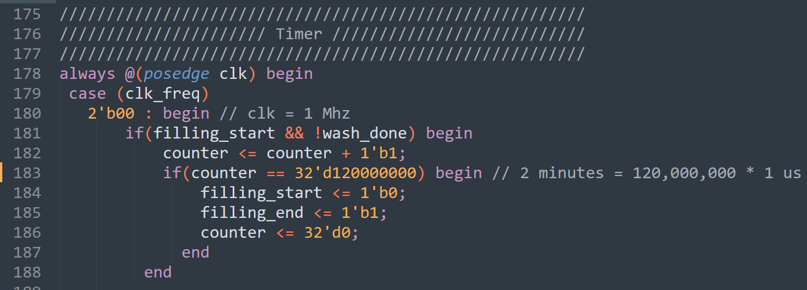
Timer
The timer is an always block that is sequential because I want to count the number of clock cycles equivalent to some duration of time. Inside this always block is a case statement which depends on the clk_freq. here is the first case which is operating at a frequency of 1 MHz. The first if statement will work at the starting of the filling state, and it will count 120,000,000 clock cycles (2 minutes) before setting the filling_start signal to zero, and the filling_end signal to one, which means that the next state will be the washing state according to the next state logic always block. The counter is set to zero before continuing to the next state.

Slide 30
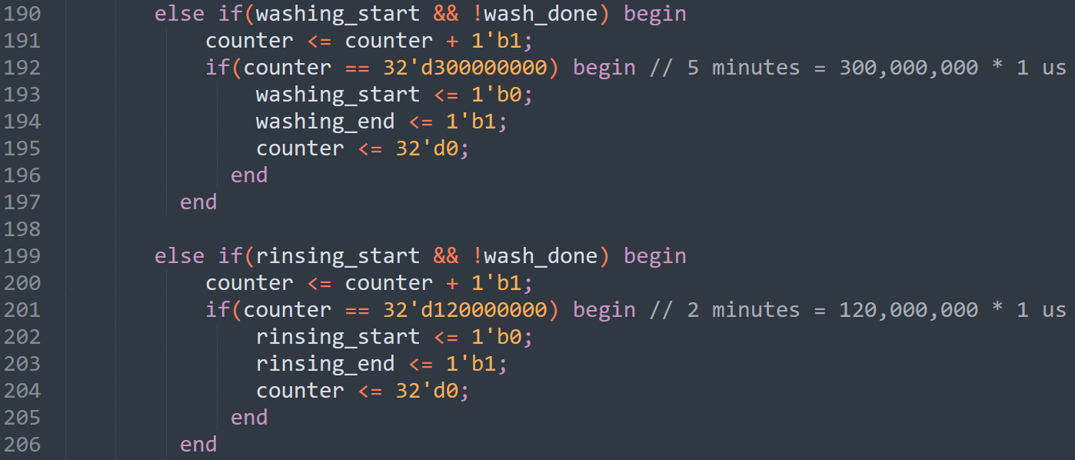
Timer
Here, is the same idea for the washing state, and the rinsing state. The difference is that each state will count different number of clock cycles than the other states.

Slide 31
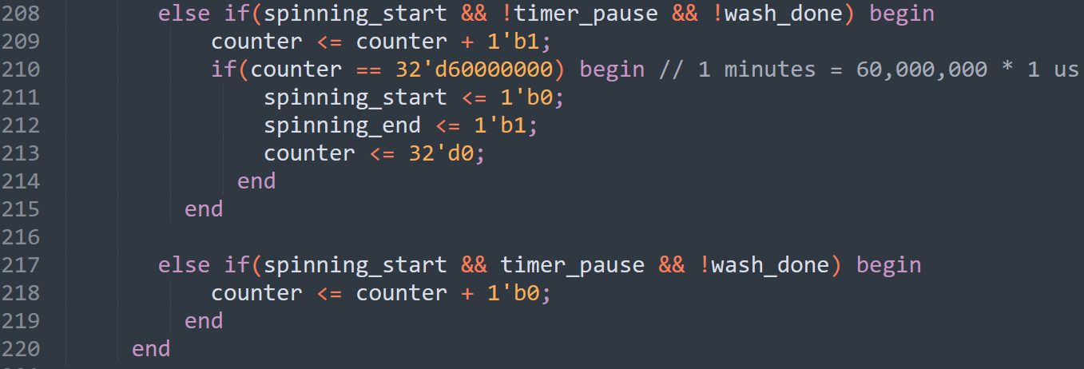
Timer
Same idea here. But, the difference is that the condition of the if statement contains the timer_pause signal as shown below, as I want to stop the timer when the timer_pause signal is set to one, then continuing the working of the timer after the timer_pause signal is set to 0.

Slide 32
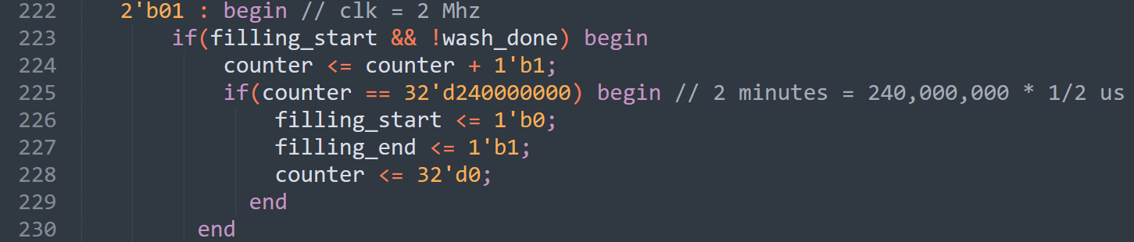
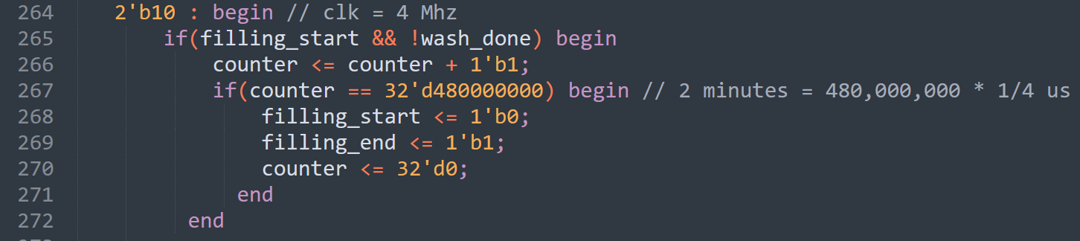
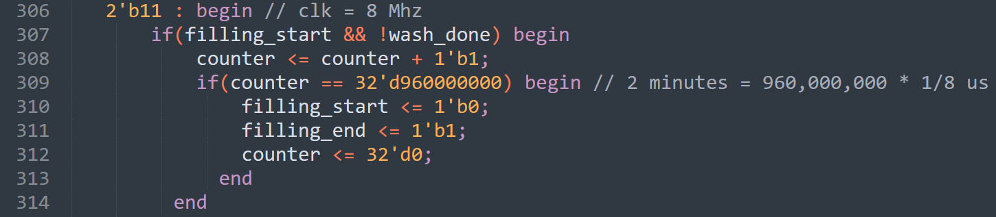
Timer
The rest of the timer code is the same as before, the only difference is that I will work on the rest of the frequencies 2MHz, 4MHz, and 8MHz.

Slide 33
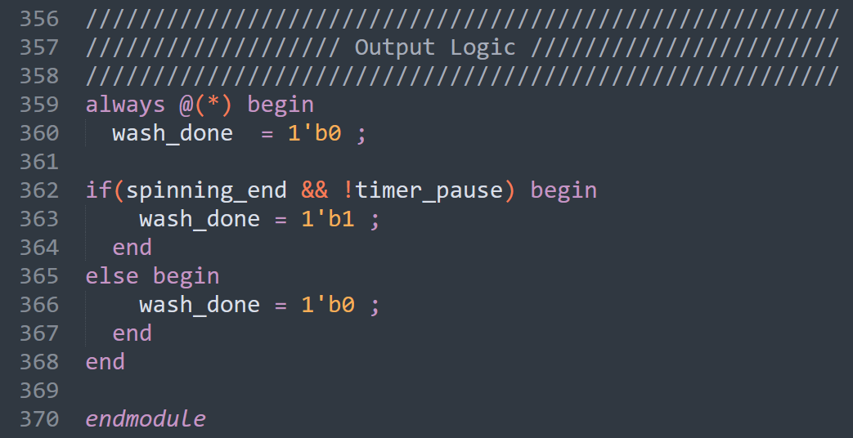
Output Logic
The output logic is a simple combinational circuit that will make the wash_done signal equal to 1 when the spinning operation is done, and the timer_pause signal is 0.

Slide 34
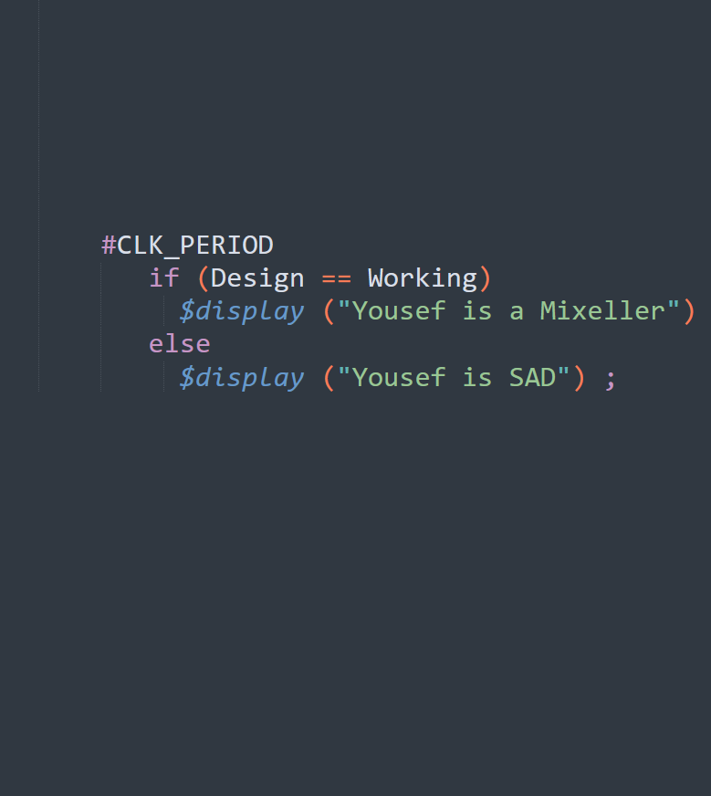
The testing covered scenarios
.

Slide 35
Testbench
Testing is done using a testbench Verilog code. It contains:
File Header
DUT Signals
DUT Instantiation
Clock Generation
Tasks
Initial Block

Slide 36
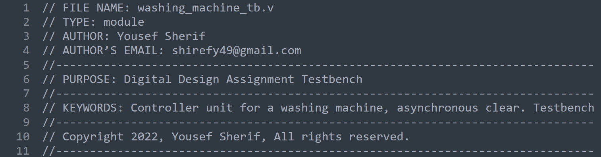
File Header
The header includes the name of the file, author, and author's email address, a purpose section explaining the functionality of the module.

Slide 37
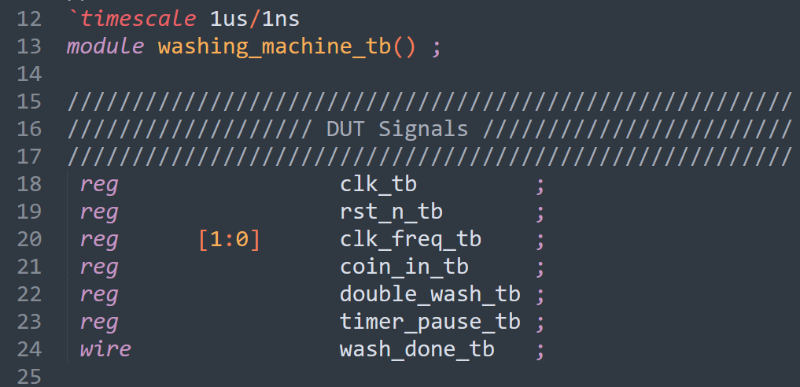
DUT Signals
Here, I define the testbench signals which will be connected to the DUT.

Slide 38
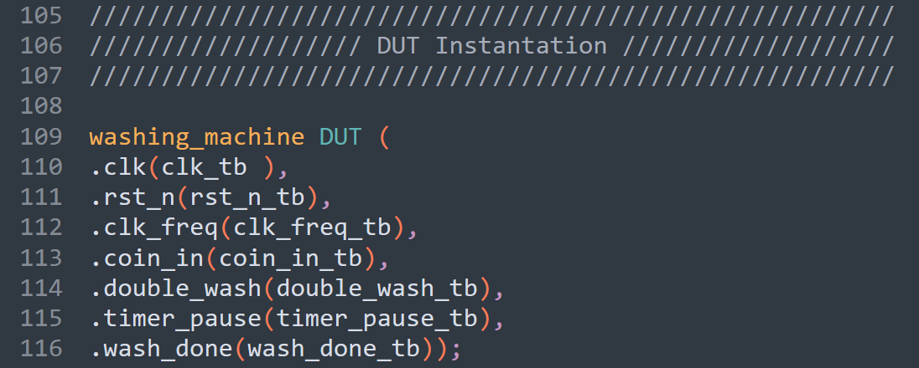
DUT Instantiation
Here, I make an instance of the main design, and I am naming it DUT. Then, I am connecting the testbench signals to the DUT signals using port mapping by name to ensure that all signals are connected correctly.

Slide 39
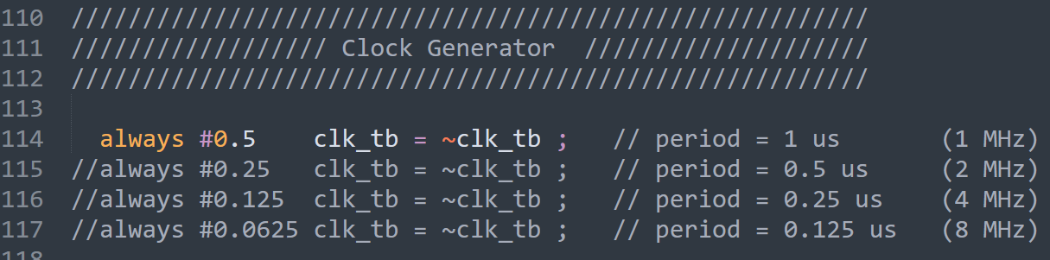
Clock Generation
Here, I define different clocks to use in my simulation. Using the `timescale compiler directive means that all numbers after the (#) will be multiplied by 1 us. For example, in the first always statement, #0.5 means that 0.5 is half the T period, multiply the T period by 1 us from the timescale gives a T period of 1 us.

Slide 40
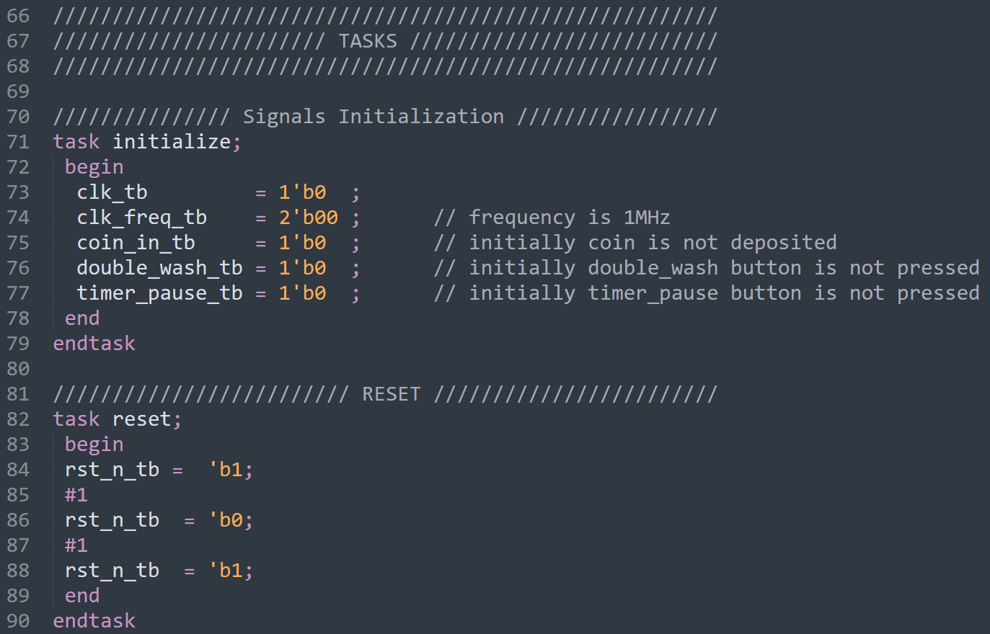
Tasks
Here, I define different tasks to be uses in the initial block. The first task is Signals Initialization, and it is used to initialize the clk, clk_freq, coin_in, double_wash, and timer_pause to a known value, here, ther are all initialized to zero. The second task in called Reset, and it is used to reset the controller using the negative edge active low reset. #1 delay means 1 us delay in the waveform of the simulation.

Slide 41
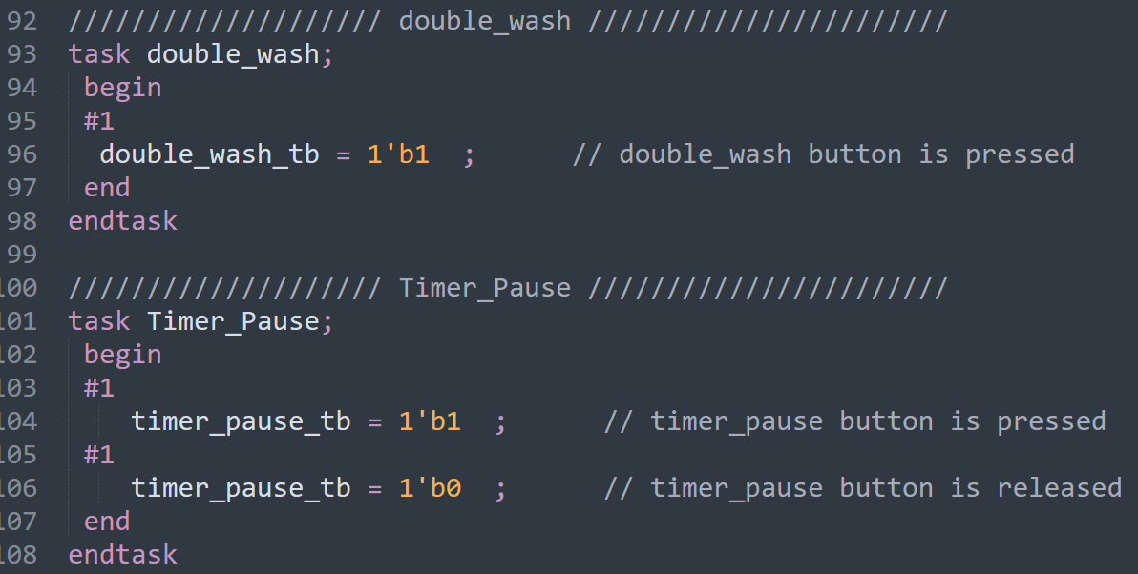
Tasks
The third task is double_wash, and it is used to initialize the clk, clk_freq, coin_in, double_wash, and timer_pause to a known value, here, ther are all initialized to zero. The second task in called Reset, and it is used to reset the controller using the negative edge active low reset.

Slide 42
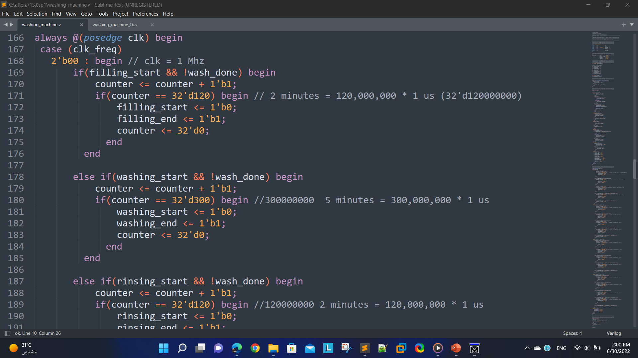
Simulation Note
Before Doing the simulation, and for the sake of making the simulation time shorter, I scaled down the time of each operation, for example, the time for the filling state is scaled down to 120 from 120,000,000.

Slide 43
Test Cases
I am going to make 6 different test simulation scenarios.
Test Case 1:
Here, we are testing the design knowing that the double wash and timer pause buttons are not pressed.
Next are the simulation results from ModelSim software. (1 MHz)
Test Case 2:
Here, we are testing the design knowing that the double wash button is pressed. But, the timer pause button is not pressed. (1 MHz)
Test Case 3:
Here, we are testing the design knowing that the double wash and timer pause buttons are both pressed.
Next are the simulation results from ModelSim software. (1 MHz)

Slide 44
Test Cases
Test Case 4:
Here, we are testing the design knowing that the double wash and timer pause buttons are both pressed.
Next are the simulation results from ModelSim software. (2 MHz)
Test Case 5:
Here, we are testing the design knowing that the double wash and timer pause buttons are both pressed.
Next are the simulation results from ModelSim software. (4 MHz)
Test Case 6:
Here, we are testing the design knowing that the double wash and timer pause buttons are both pressed.
Next are the simulation results from ModelSim software. (8 MHz)

Slide 45
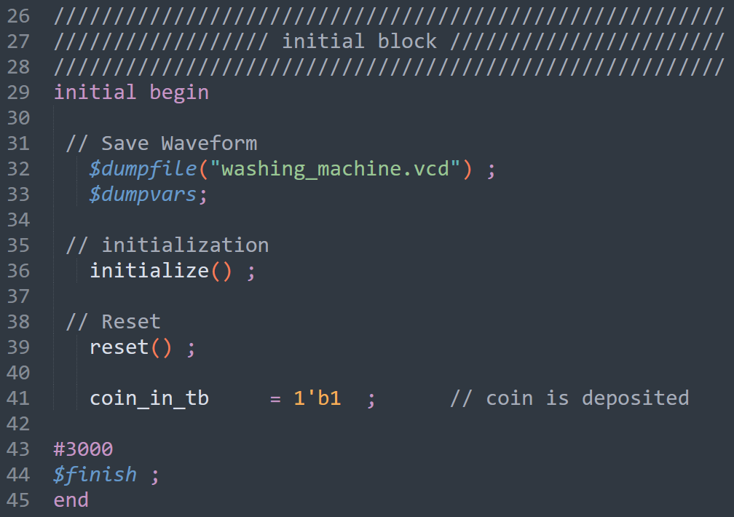
Initial Block (Test Case 1)
Here, we are testing the design knowing that the double wash and timer pause buttons are not pressed.
Next are the simulation results from ModelSim software. (1 MHz)

Slide 46
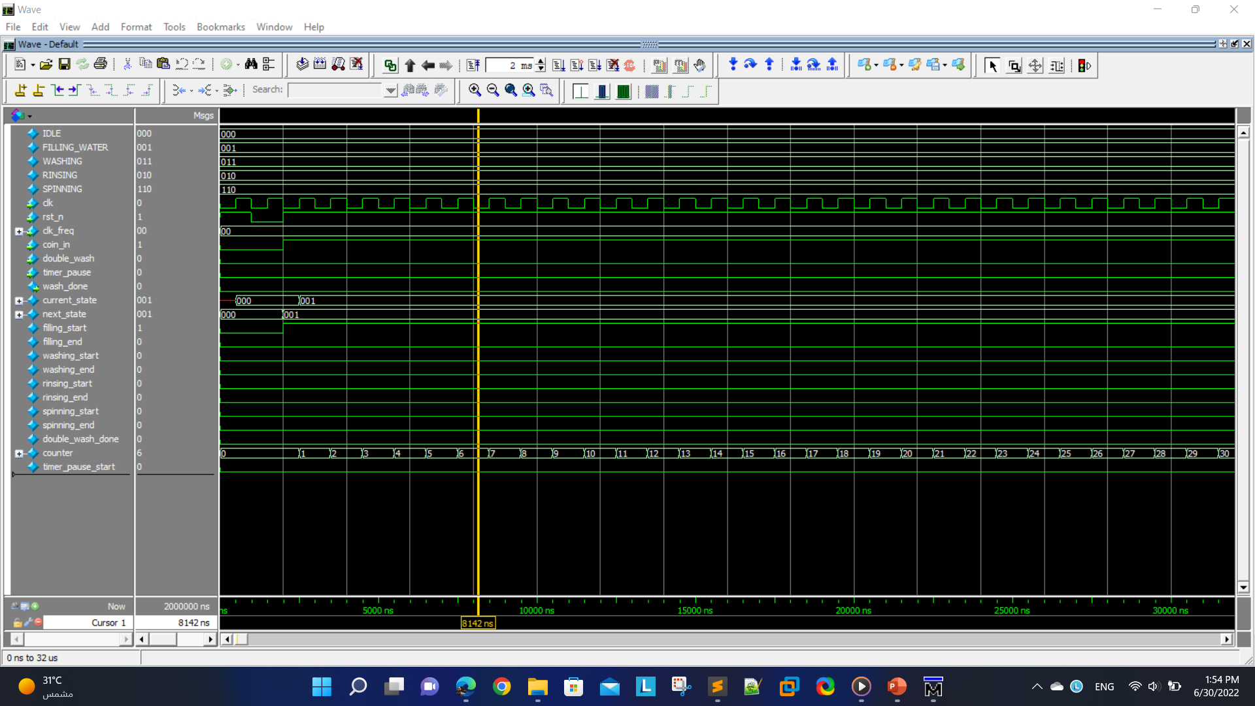
At the beginning.

Slide 47
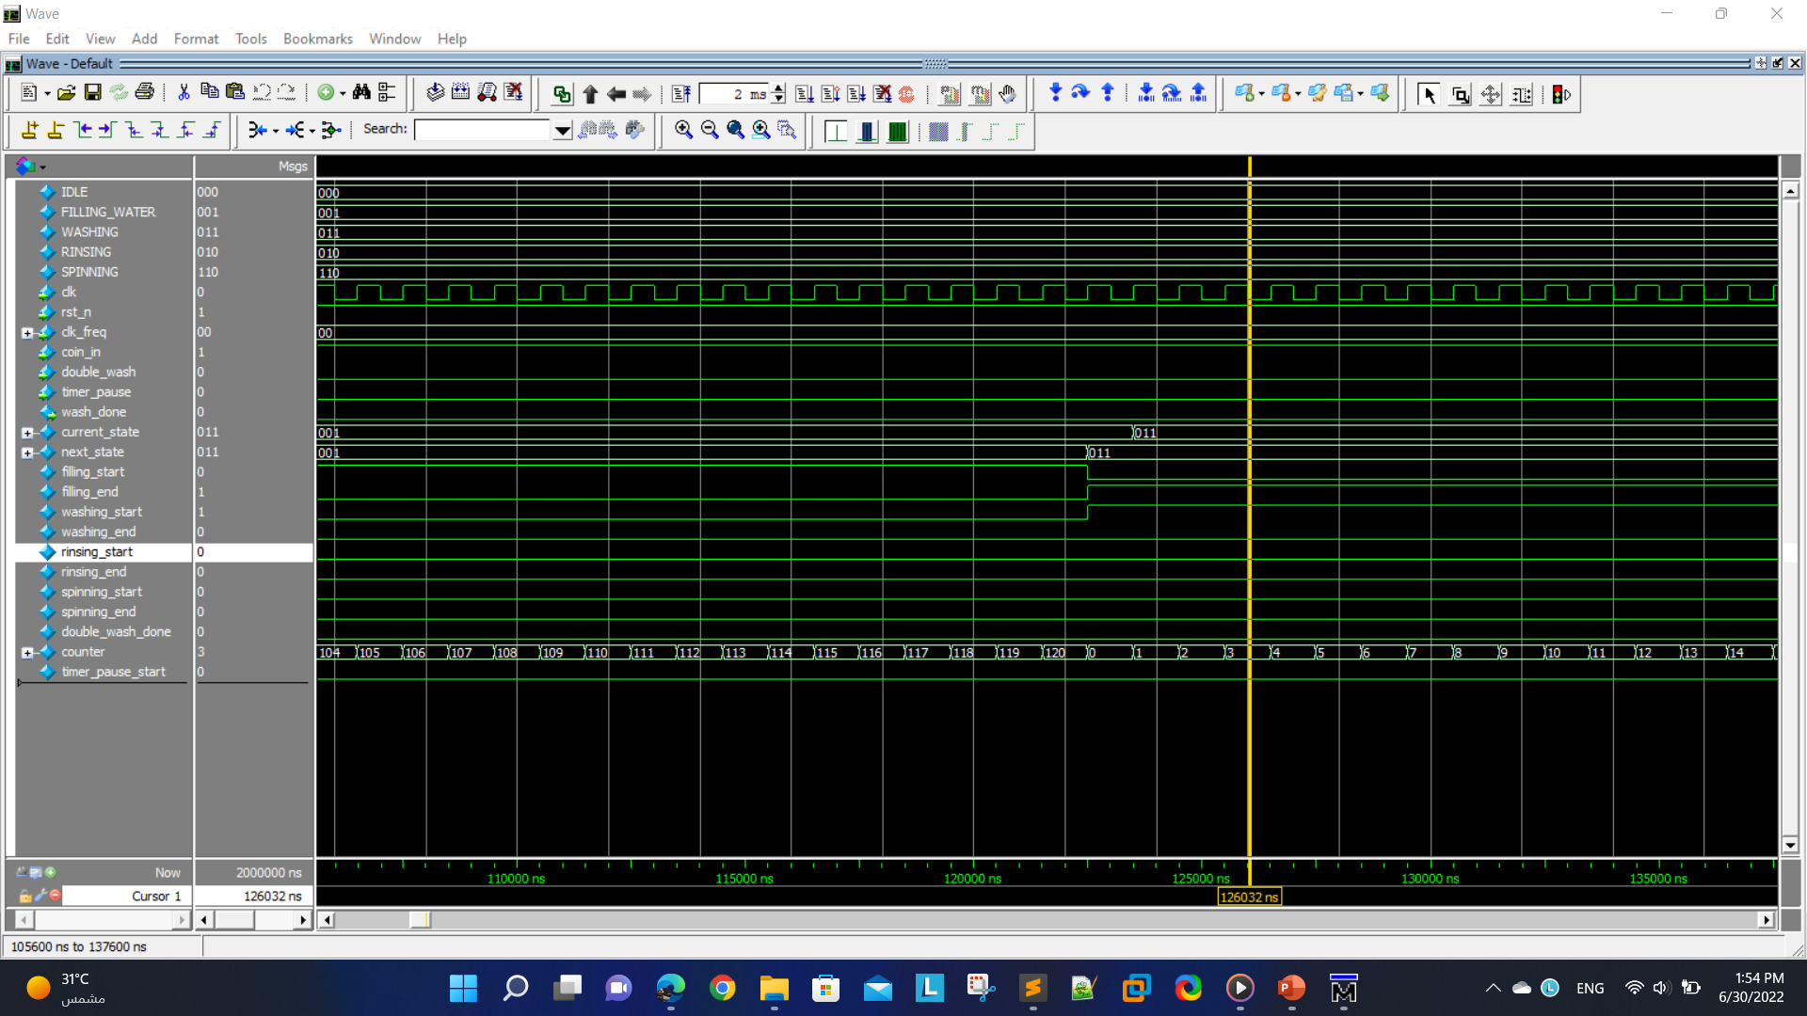
After the filling state is done. (2 Minutes = 120 clock cycles after scaling down)

Slide 48
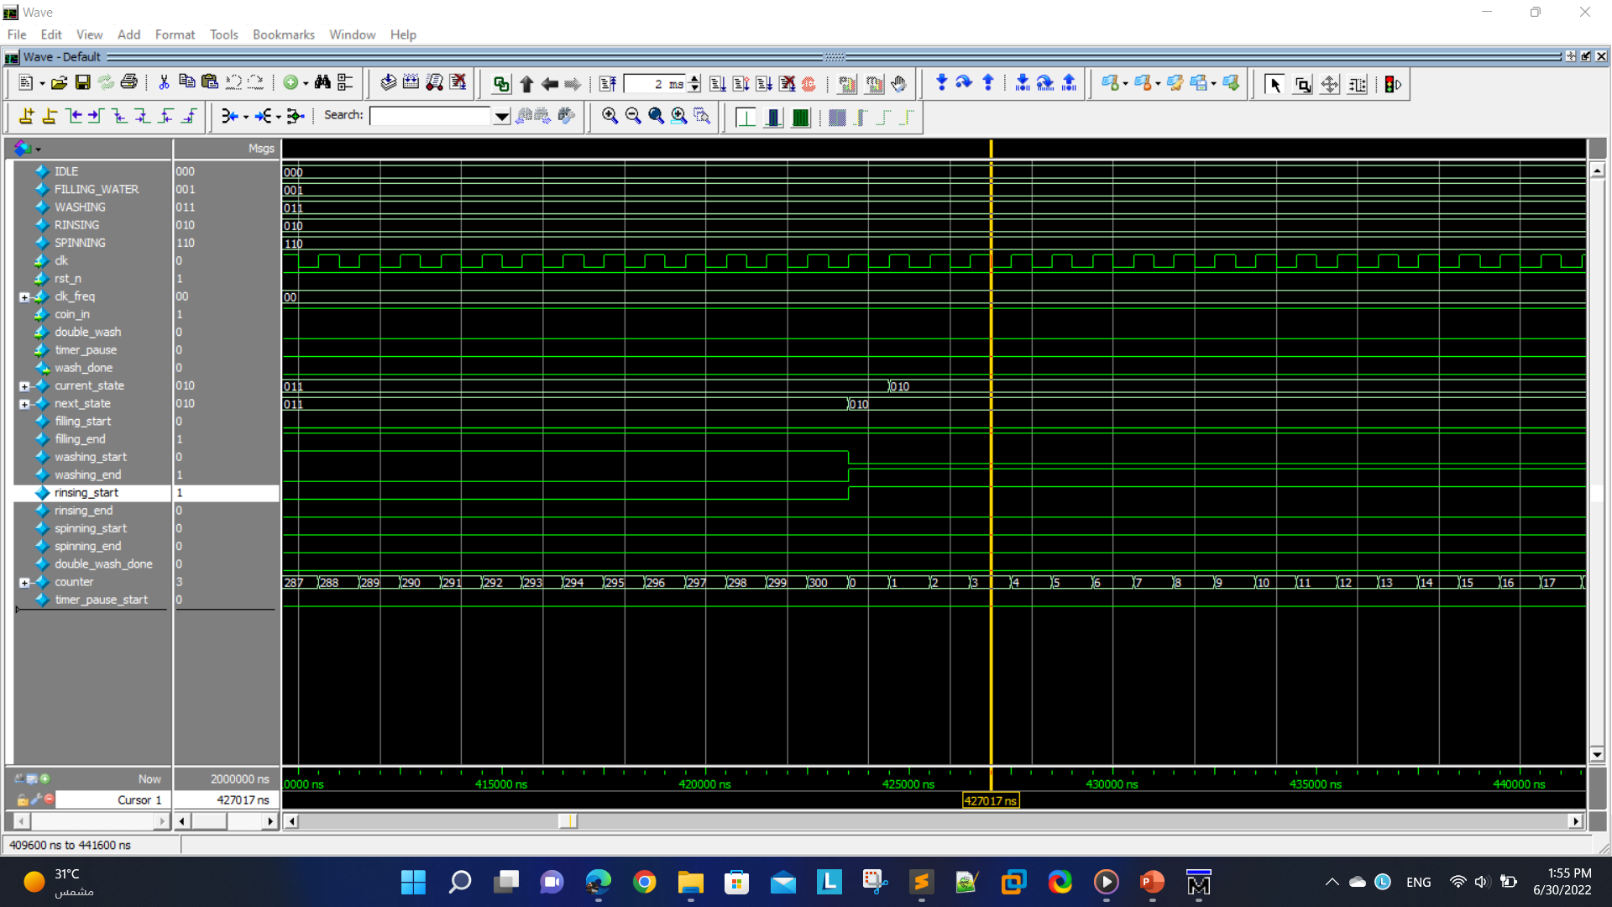
After the washing state is done. (5 Minutes = 300 clock cycles after scaling down)

Slide 49

After the rinsing state is done. (2 Minutes = 120 clock cycles after scaling down)

Slide 50
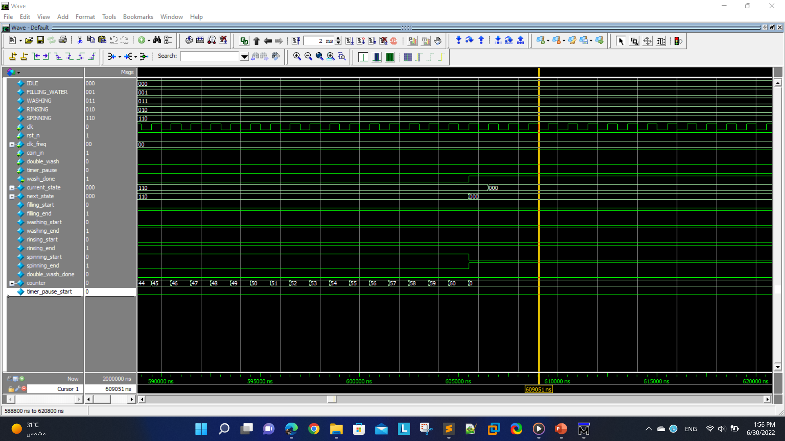
After the spinning state is done. (1 Minute = 60 clock cycles after scaling down)

Slide 51
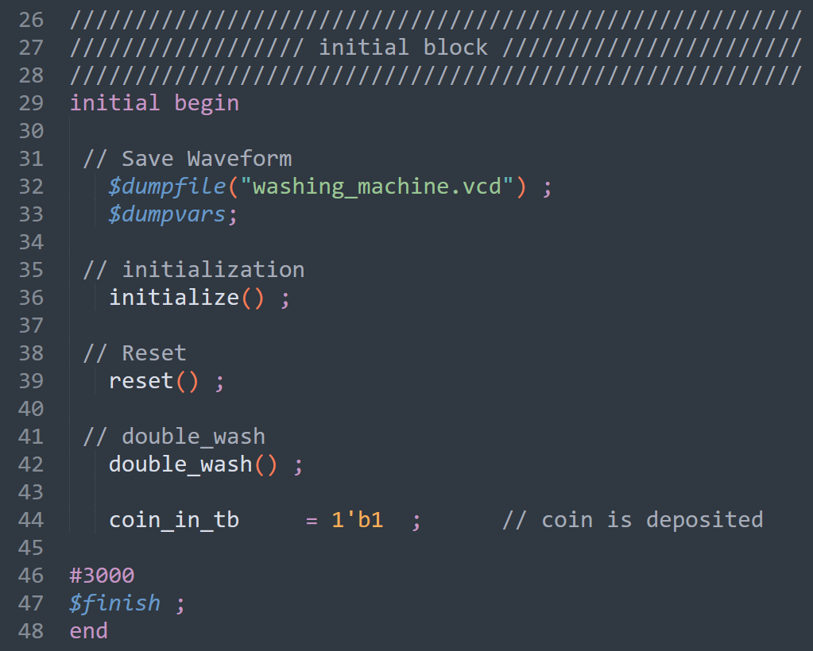
Initial Block (Test Case 2)
Here, we are testing the design knowing that the double wash button is pressed. But, the timer pause button is not pressed. (1 MHz)

Slide 52
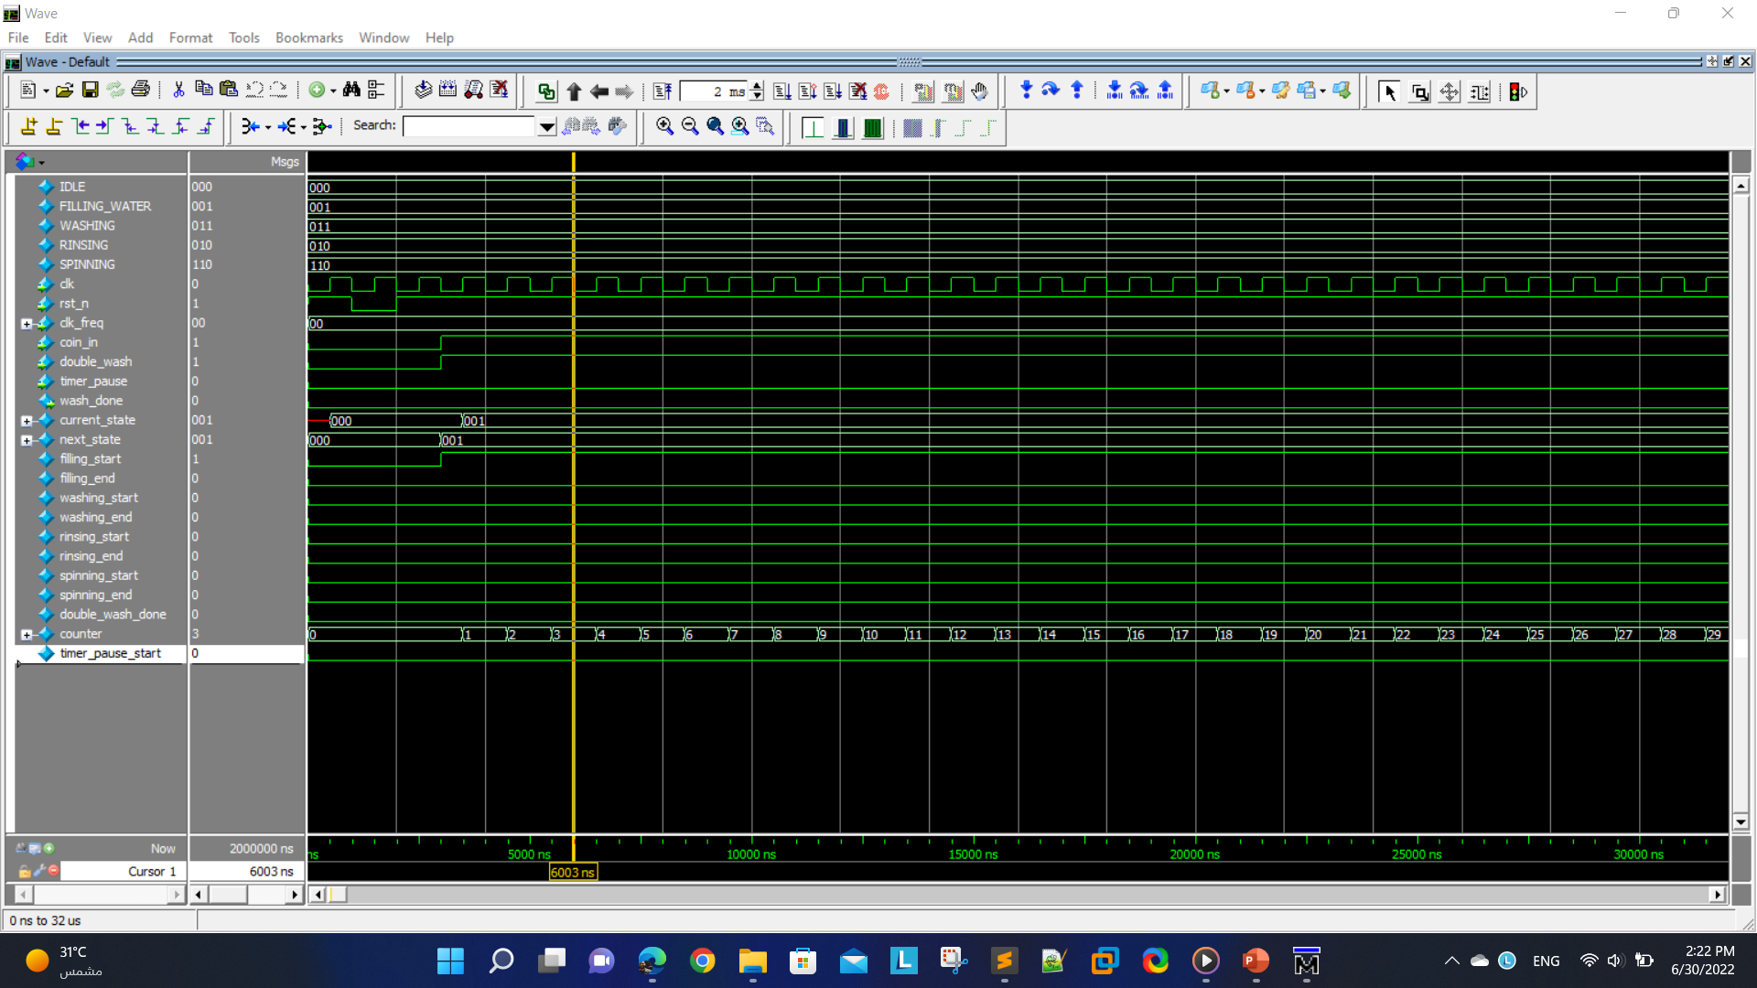
At the beginning.

Slide 53

After the filling state is done. (2 Minutes = 120 clock cycles after scaling down)

Slide 54

After the first washing state is done. (5 Minutes = 300 clock cycles after scaling down)

Slide 55
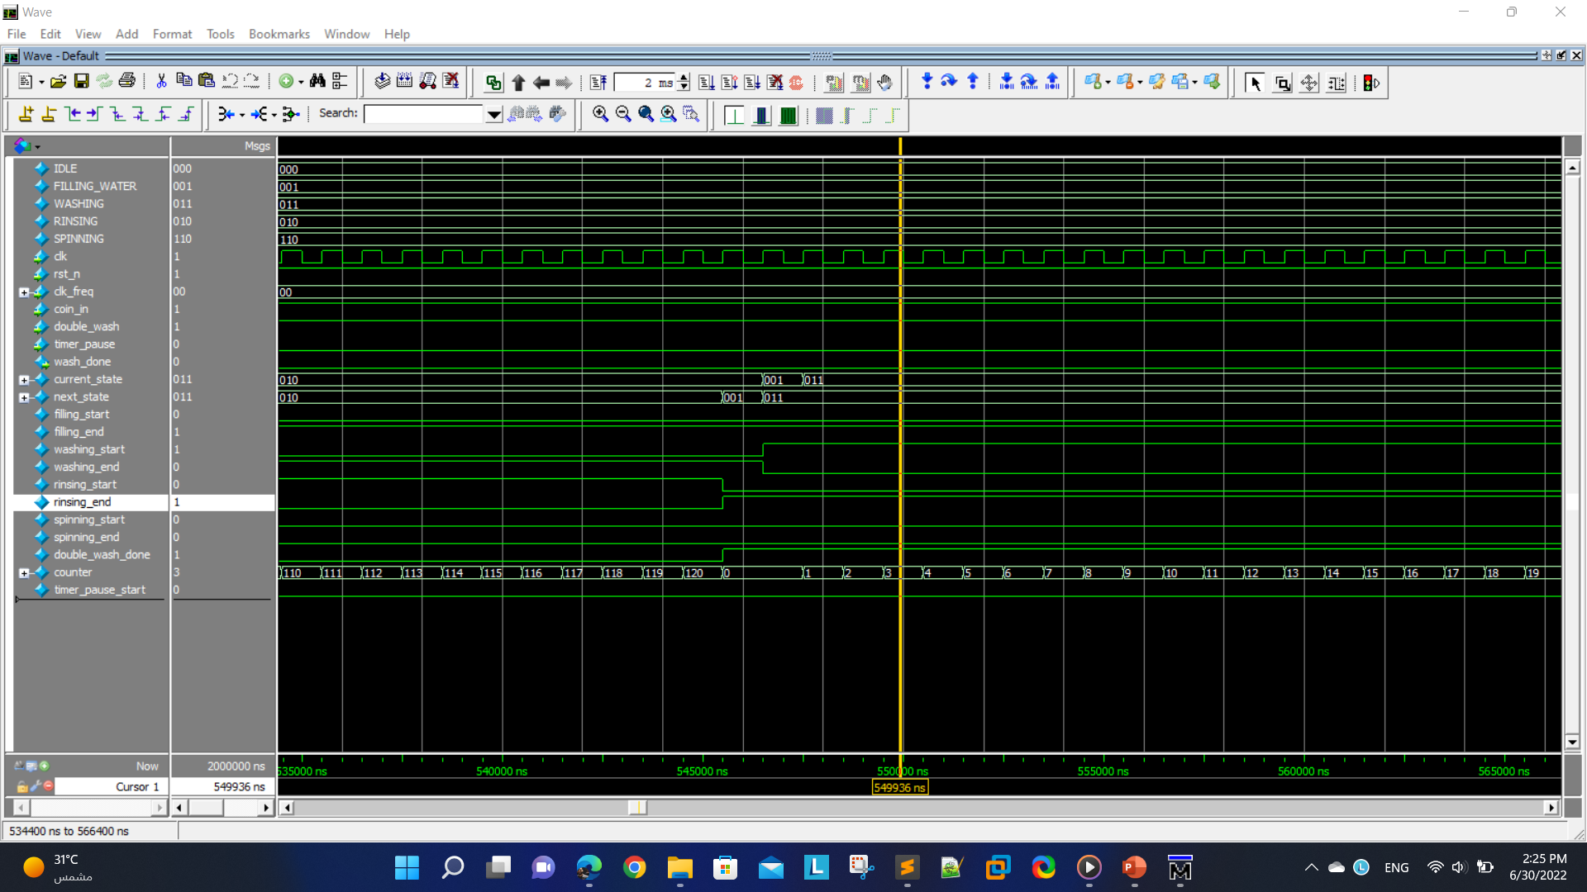
After the first rinsing state is done. (2 Minutes = 120 clock cycles after scaling down)

Slide 56
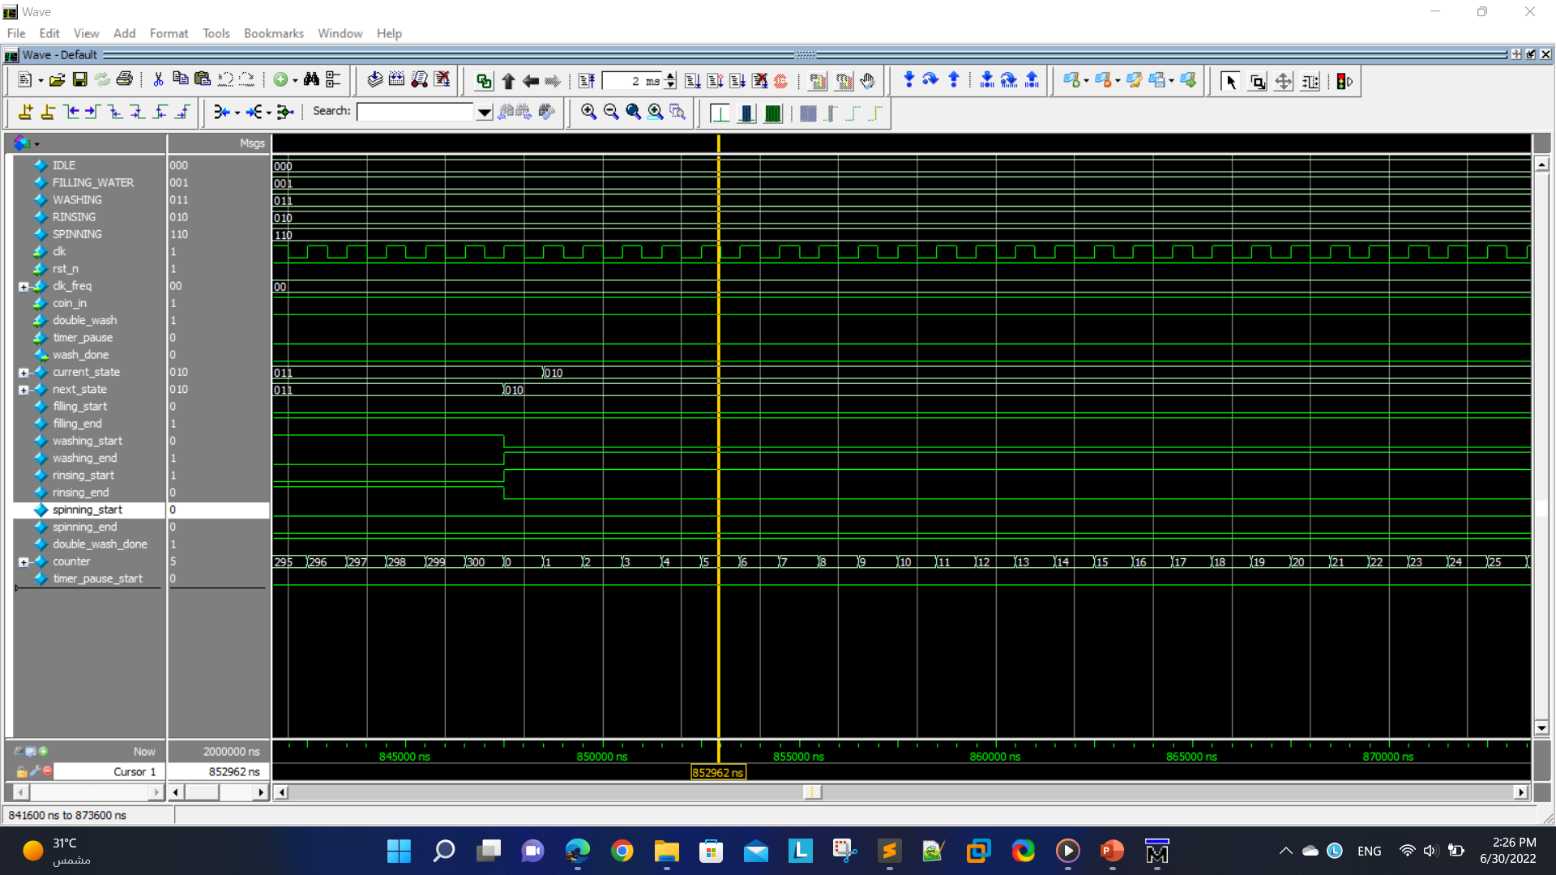
After the second washing state is done. (5 Minutes = 300 clock cycles after scaling down)

Slide 57

After the second rinsing state is done. (2 Minutes = 120 clock cycles after scaling down)

Slide 58
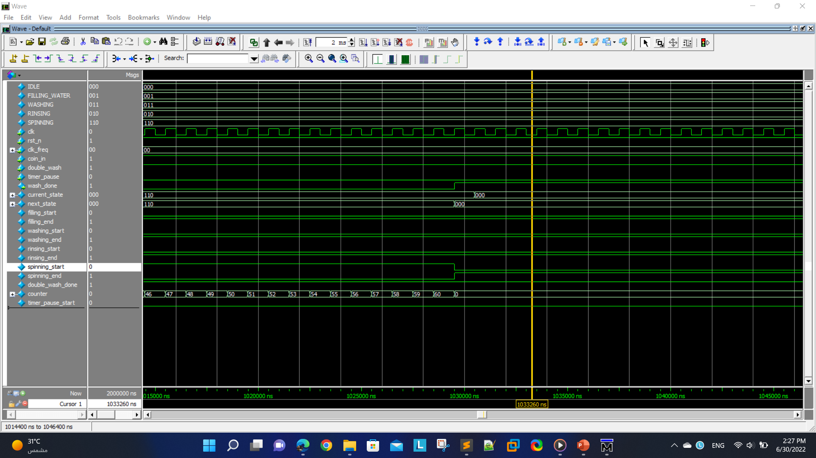
After the spinning state is done. (1 Minute = 60 clock cycles after scaling down)

Slide 59
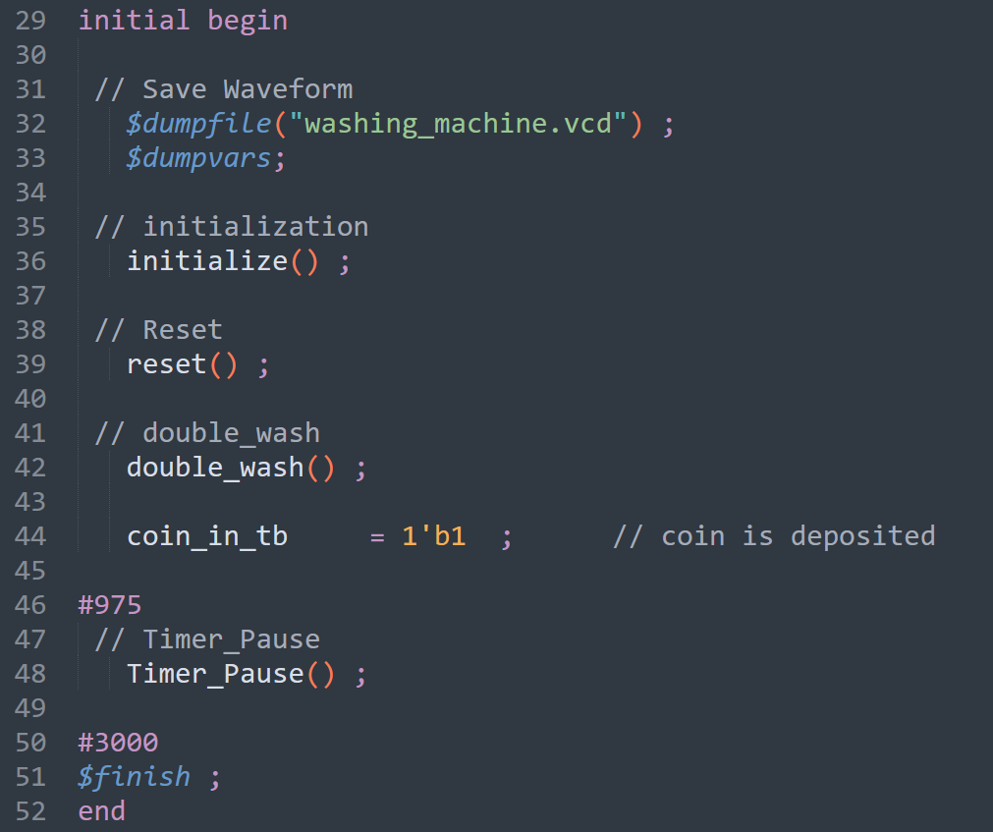
Initial Block (Test Case 3)
Here, we are testing the design knowing that the double wash and timer pause buttons are both pressed.
Next are the simulation results from ModelSim software. (1 MHz)

Slide 60

At the beginning.

Slide 61
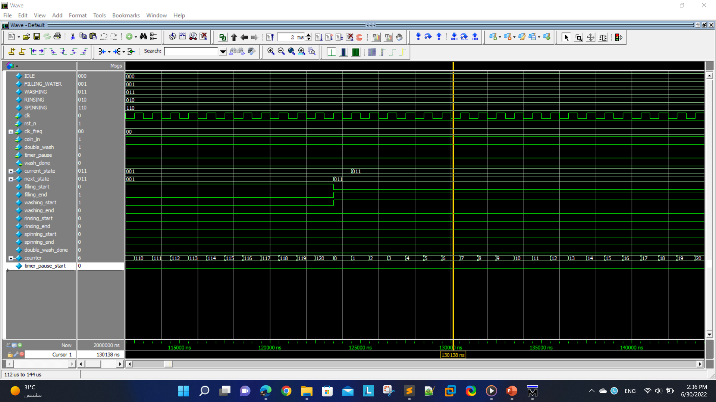
After the filling state is done. (2 Minutes = 120 clock cycles after scaling down)

Slide 62

After the first washing state is done. (5 Minutes = 300 clock cycles after scaling down)

Slide 63

After the first rinsing state is done. (2 Minutes = 120 clock cycles after scaling down)

Slide 64

After the second washing state is done. (5 Minutes = 300 clock cycles after scaling down)

Slide 65
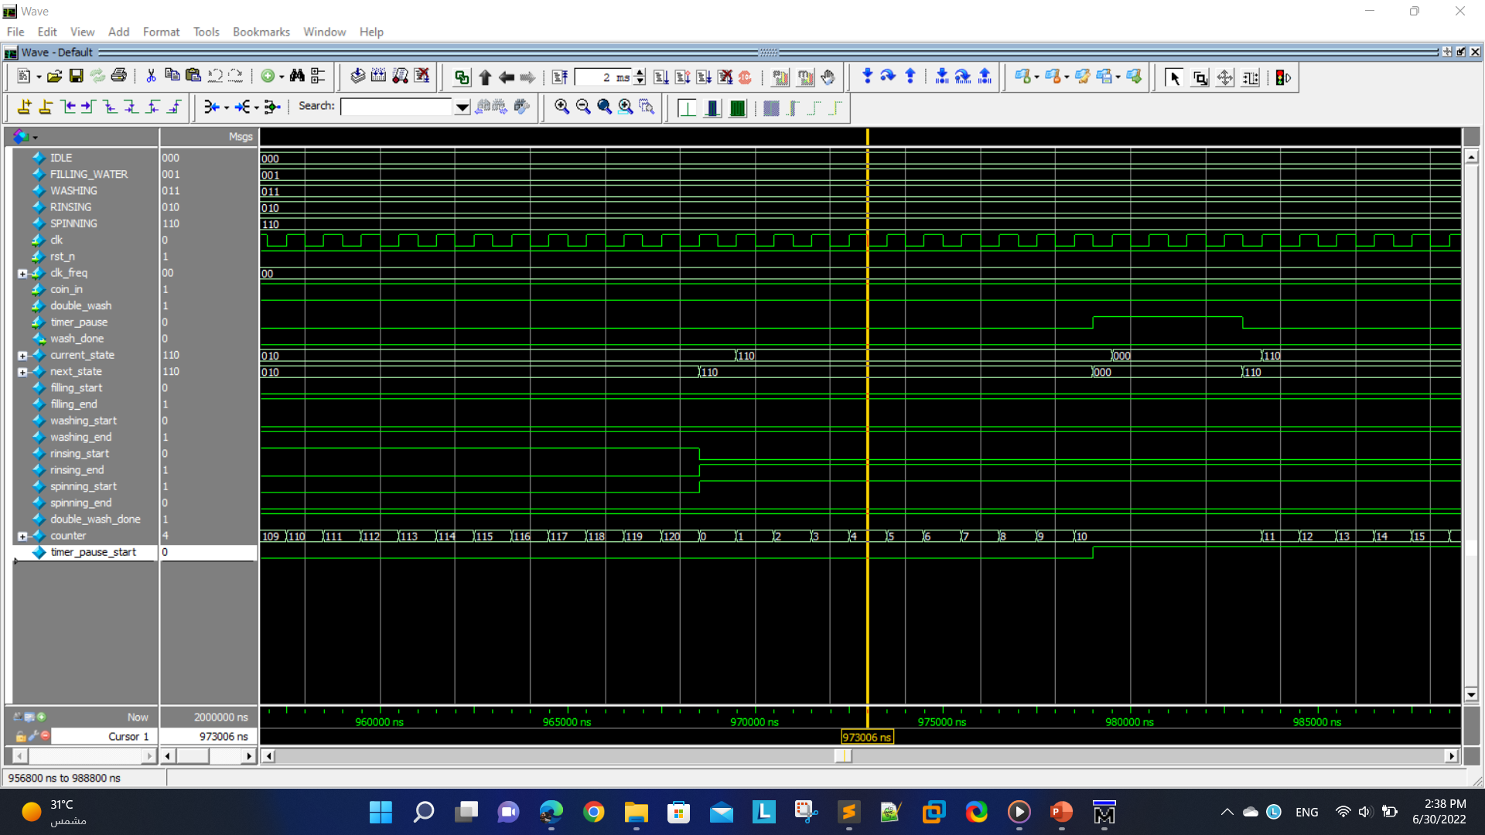
After the second rinsing state is done. (2 Minutes = 120 clock cycles after scaling down), and the timer pause is pressed during spinning.

Slide 66
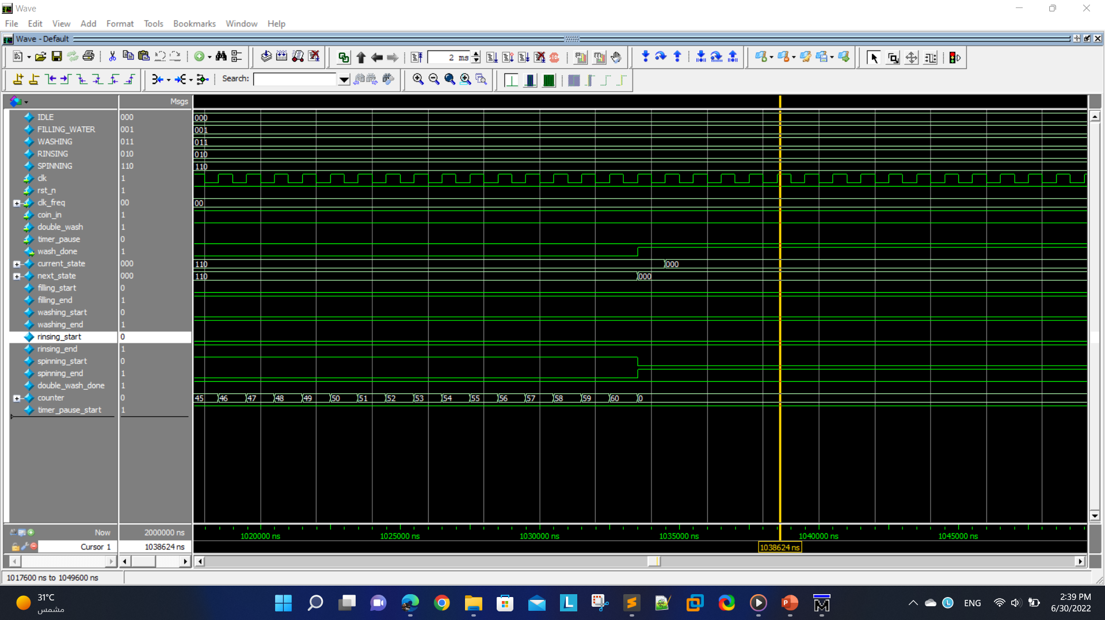
After the spinning state is done. (1 Minute = 60 clock cycles after scaling down)

Slide 67
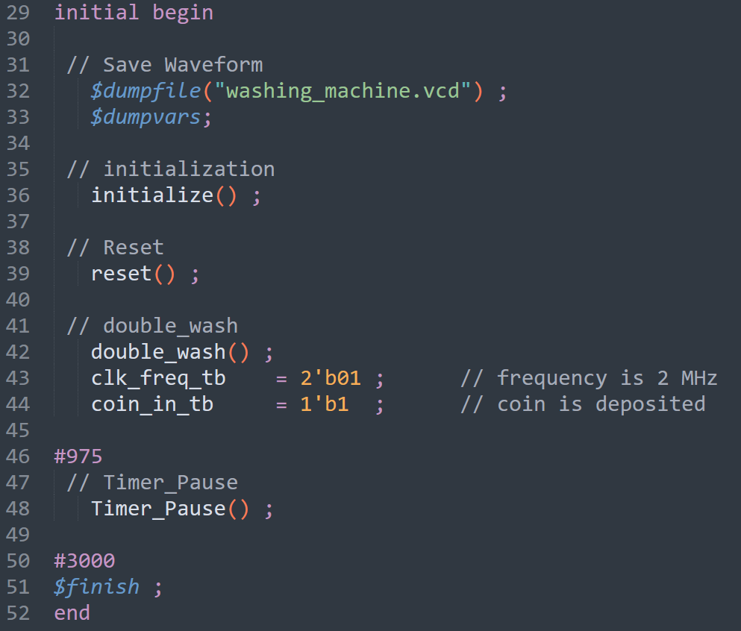
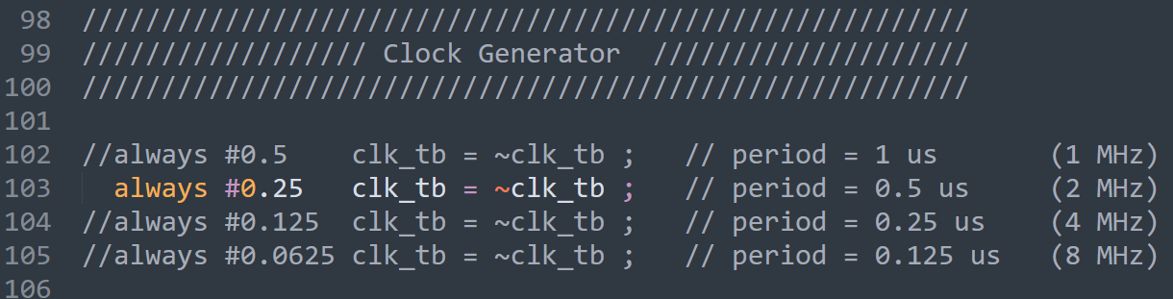
Initial Block (Test Case 4)
Here, we are testing the design knowing that the double wash and timer pause buttons are both pressed.
Next are the simulation results from ModelSim software. (2 MHz)

Slide 68

At the beginning.

Slide 69

After the filling state is done. (2 Minutes = 240 clock cycles after scaling down)

Slide 70

After the first washing state is done. (5 Minutes = 600 clock cycles after scaling down)

Slide 71

After the first rinsing state is done. (2 Minutes = 240 clock cycles after scaling down)

Slide 72

After the second washing state is done. (5 Minutes = 600 clock cycles after scaling down)

Slide 73

After the second rinsing state is done. (2 Minutes = 240 clock cycles after scaling down)

Slide 74

Timer pause button is pressed during spinning.

Slide 75

After the spinning state is done (1 minute = 120 clock cycles after scaling down).

Slide 76


Initial Block (Test Case 5)
Here, we are testing the design knowing that the double wash and timer pause buttons are both pressed.
Next are the simulation results from ModelSim software. (4 MHz)

Slide 77

At the beginning.

Slide 78

After the filling state is done. (2 Minutes = 480 clock cycles after scaling down)

Slide 79

After the first washing state is done. (5 Minutes = 1200 clock cycles after scaling down)

Slide 80

After the first rinsing state is done. (2 Minutes = 480 clock cycles after scaling down)

Slide 81

After the second washing state is done. (5 Minutes = 1200 clock cycles after scaling down)

Slide 82

After the second rinsing state is done. (2 Minutes = 480 clock cycles after scaling down)

Slide 83

Timer pause button is pressed during spinning.

Slide 84

After the spinning state is done (1 minute = 240 clock cycles after scaling down).

Slide 85


Initial Block (Test Case 6)
Here, we are testing the design knowing that the double wash and timer pause buttons are both pressed.
Next are the simulation results from ModelSim software. (8 MHz)

Slide 86

At the beginning.

Slide 87

After the filling state is done. (2 Minutes = 960 clock cycles after scaling down)

Slide 88

After the first washing state is done. (5 Minutes = 2400 clock cycles after scaling down)

Slide 89

After the first rinsing state is done. (2 Minutes = 960 clock cycles after scaling down)

Slide 90

After the second washing state is done. (5 Minutes = 2400 clock cycles after scaling down)

Slide 91

After the second rinsing state is done. (2 Minutes = 960 clock cycles after scaling down)

Slide 92

Timer pause button is pressed during spinning.

Slide 93

After the spinning state is done (1 minute = 480 clock cycles after scaling down).

Slide 94
Contact Info.
Yousef Sherif
LinkedIn: https://www.linkedin.com/in/yousef-sherif-6343b219b/
Email: shirefy49@gmail.com
Phone Number: 01098307950
Design and Testbench Link
https://drive.google.com/drive/folders/1rP7rD-fCSyzJzpP3ytStmZZrxpRLwOrx?usp=sharing

